Slide 1
Roadmap to a Successful Cloud Banking Adoption
Confidential
Notes:
Important Note: Sharing the information on this presentation with prospects is only possible under NDA. Regarding partners and customers, we have agreements already in place to protect this kind of information when being shared.
Asset Owner: SSKM Team

Slide 2
Why Transitioning to Cloud Banking Is the Best Solution
Confidential

Slide 3
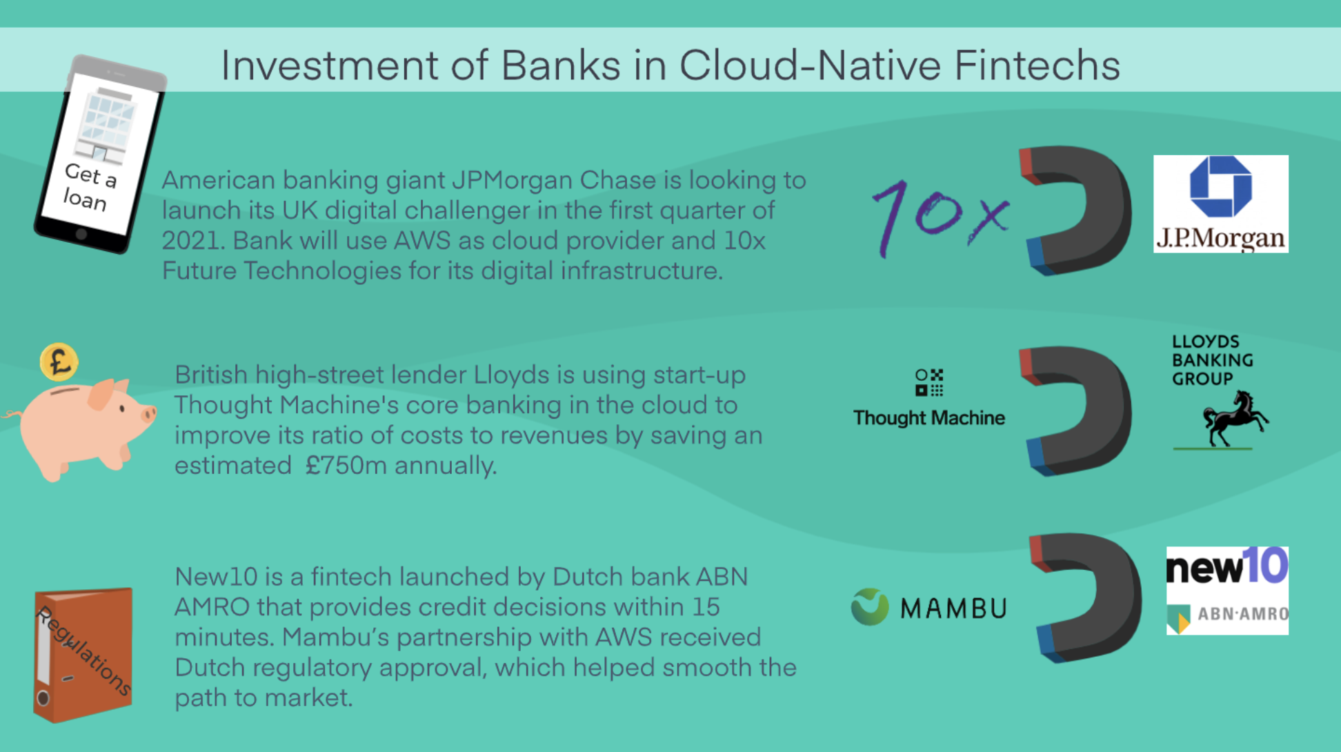
Banks invest on cloud-native fintech to set themselves up for a new era of banking
Confidential
Notes:
More and more traditional financial institutions invest on cloud software / solutions to achieve two important things: 1) Cost reduction, 2) More market profit as they have more opportunities. Here are some examples to show customers.
Additional information for those customers who want to know more:
JP Morgan Chase: https://news.sky.com/story/jpmorgan-to-challenge-uk-banks-with-digital-launch-in-early-2021-12053699
Lloyds: https://www.fintechfutures.com/2019/01/lloyds-to-cut-costs-with-thought-machine-platform-move/

Slide 4
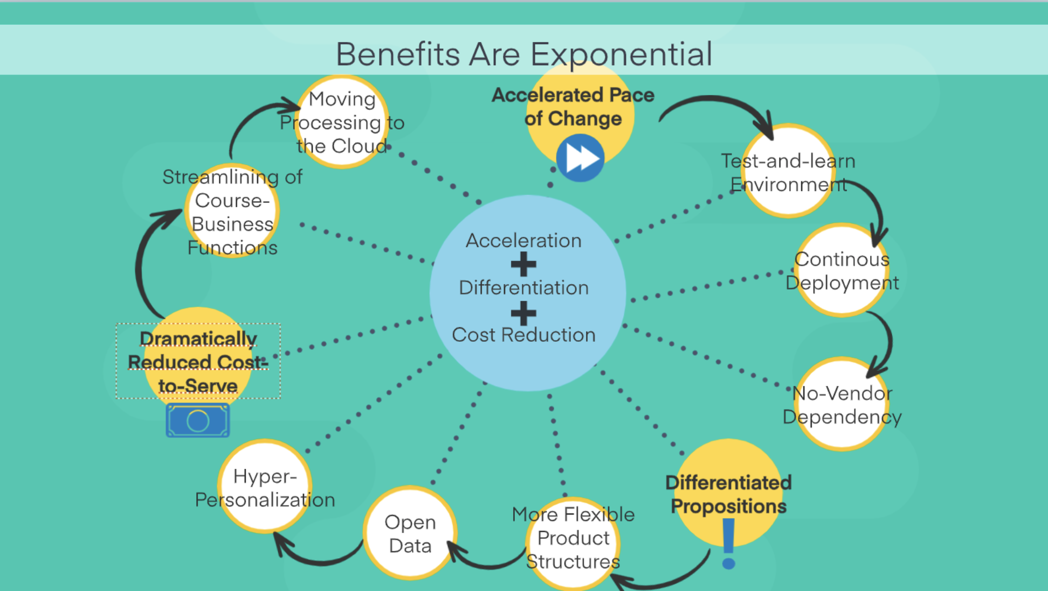
Why are banks making bets on cloud-native fintechs now?
Confidential

Slide 5
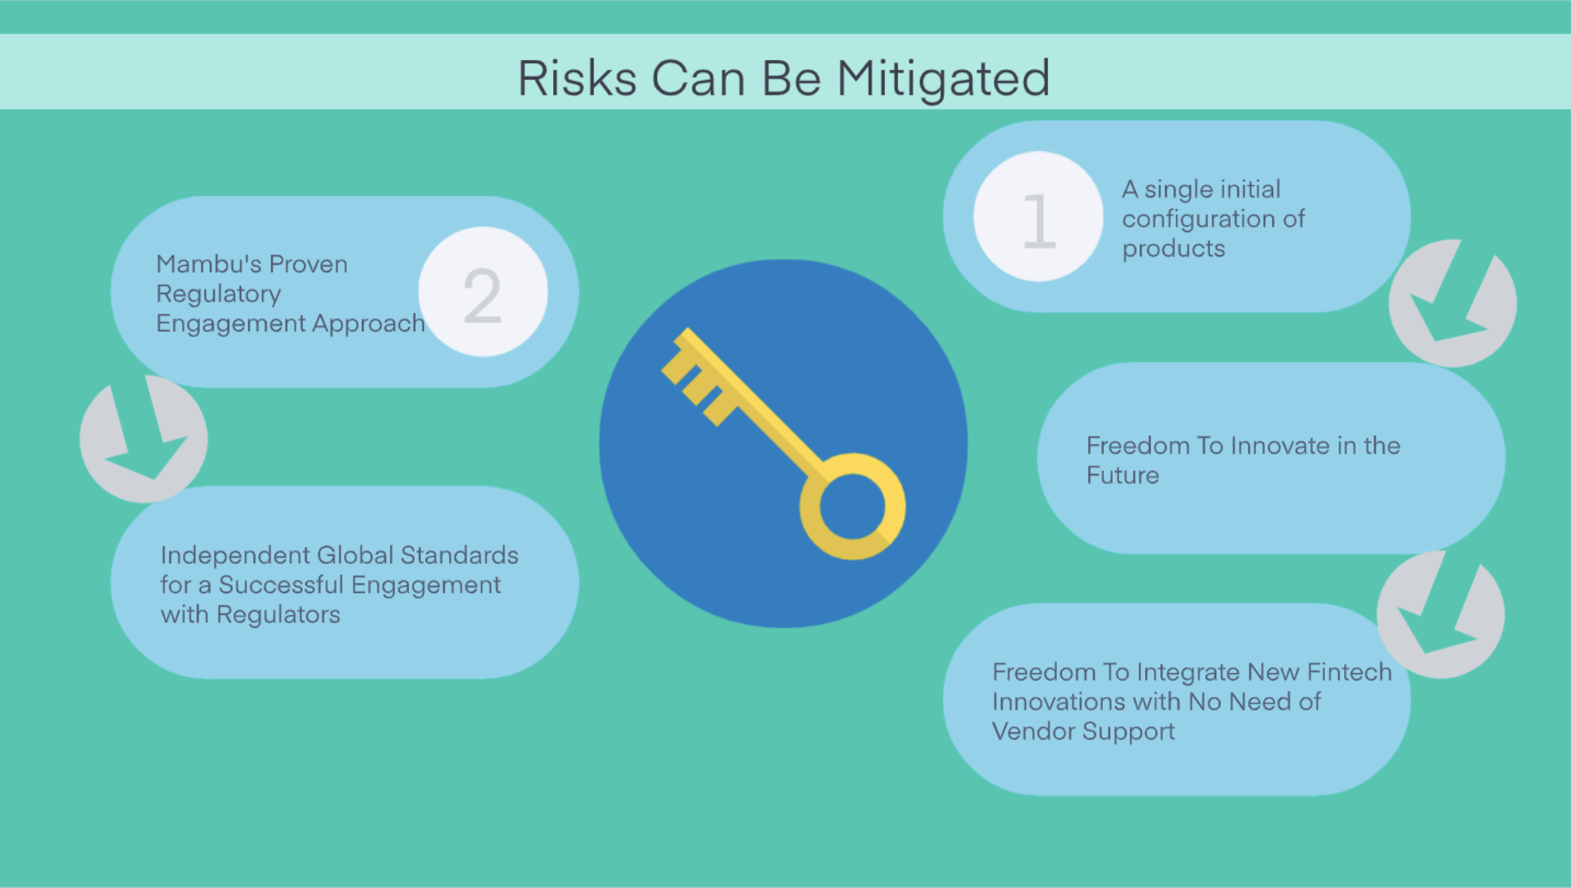
Why are banks making bets on cloud-native fintechs now?
Confidential

Slide 6
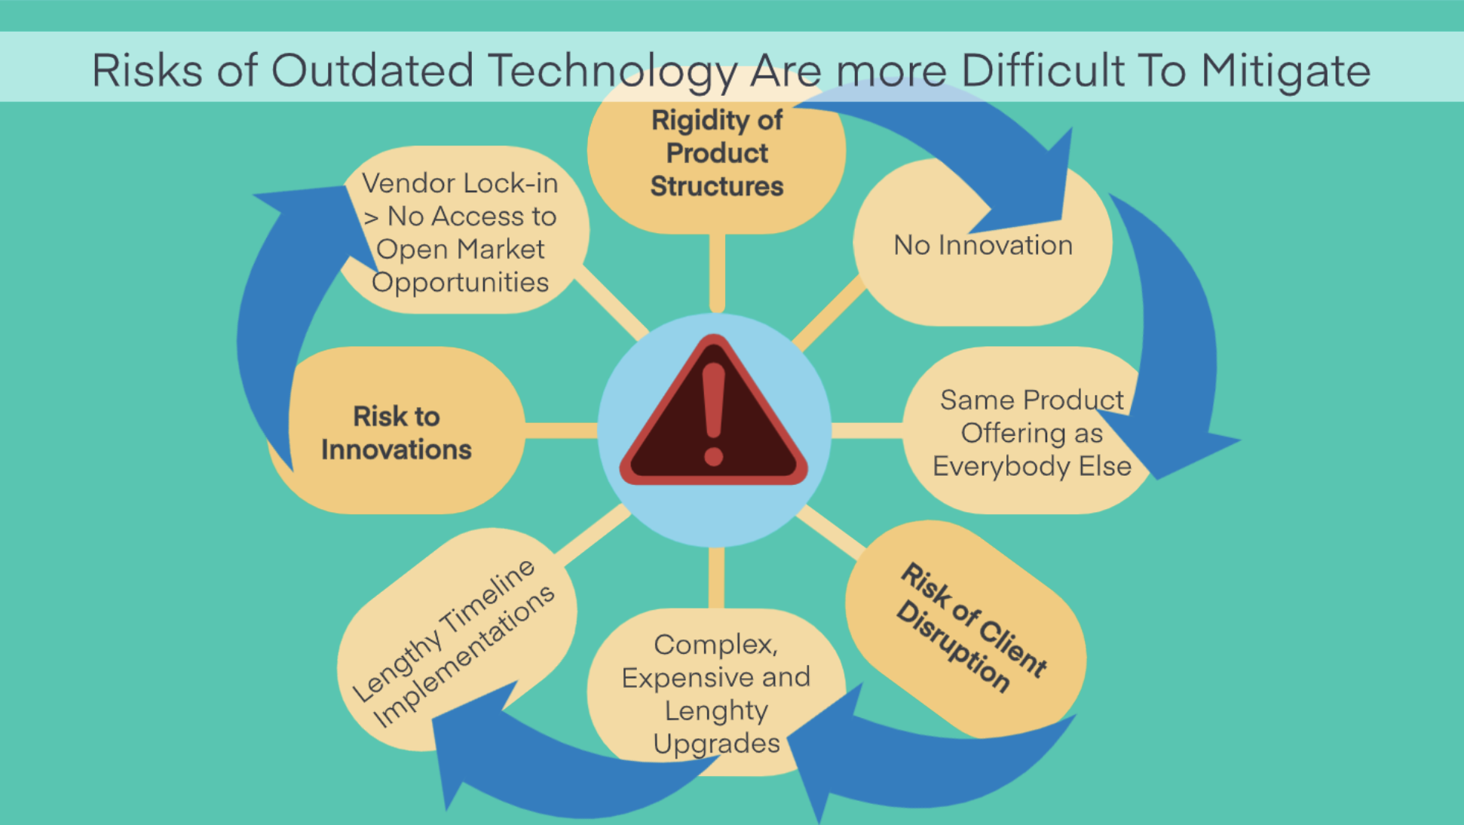
Why are banks making bets on cloud-native fintechs now?
Confidential

Slide 7
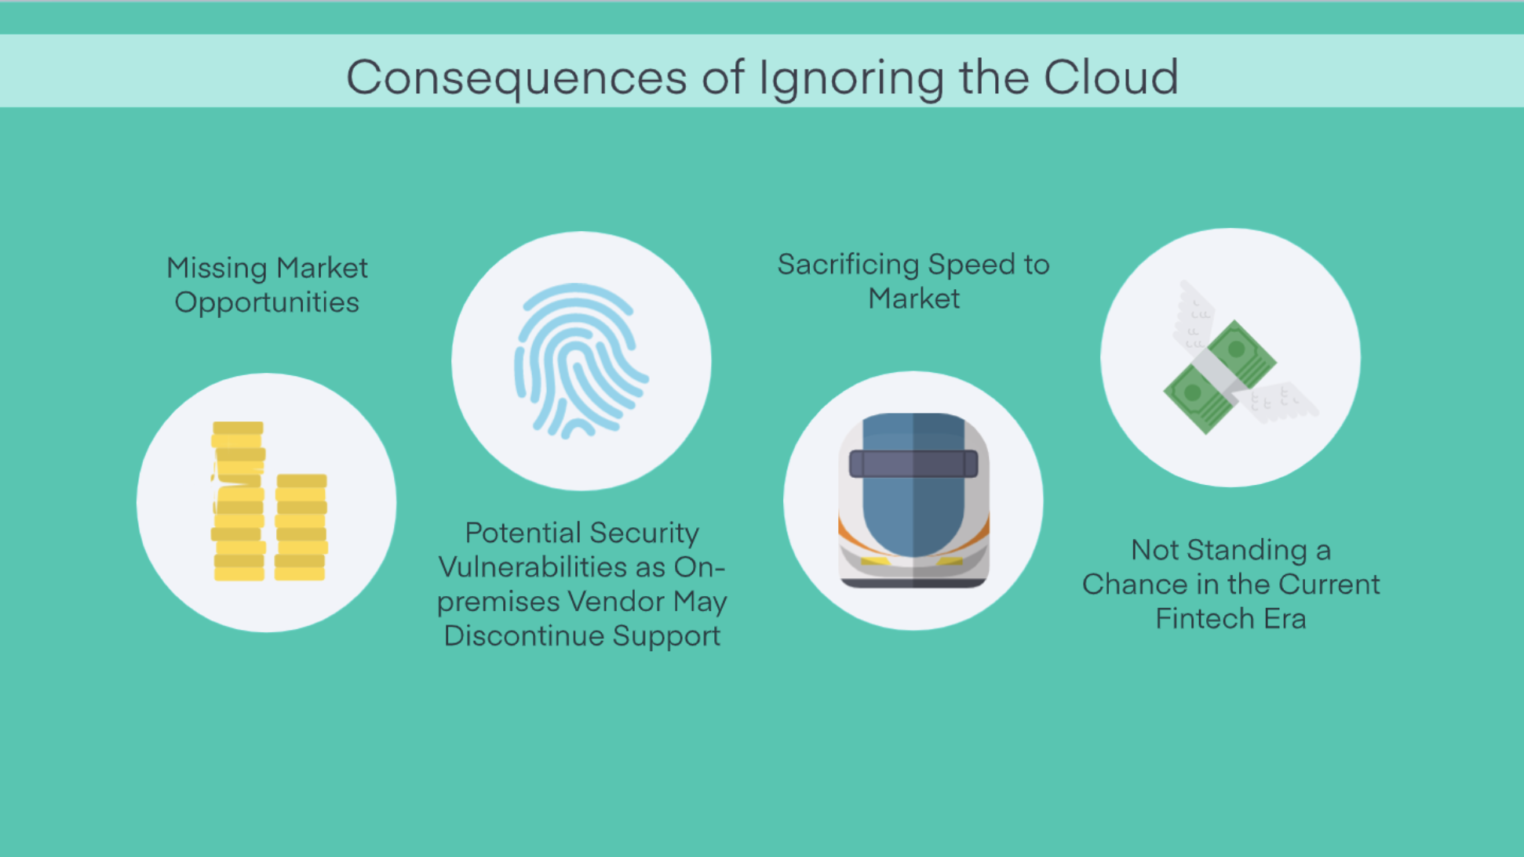
What Happens if You Ignore the Cloud?
Confidential

Slide 8
Roadmap to a Successful Cloud Banking Adoption
Confidential

Slide 9
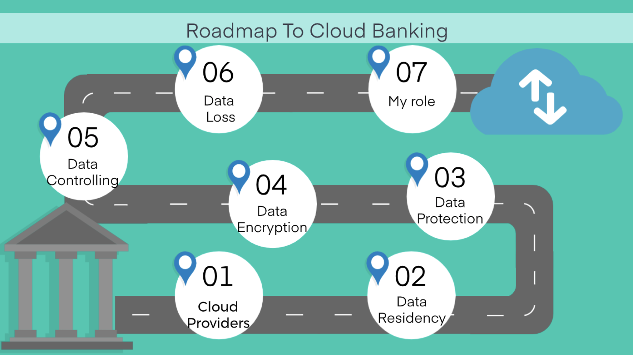
Confidential
Notes:
Note: The idea here is to offer prospects and customers some guidance regarding cloud adoption. But, of course, while suggesting what the best route is, we’ll also include valuable information about Mambu’s (as well as its third-party providers’) security and compliance policies in place.

Slide 10
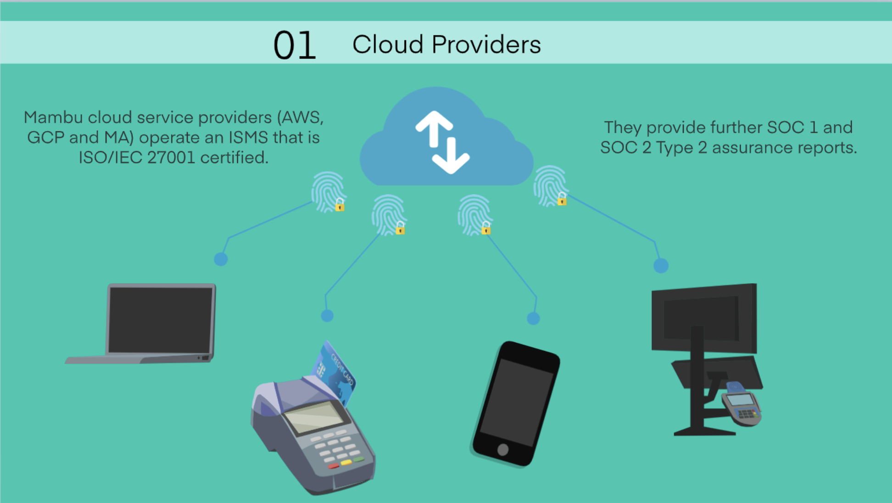
What Kind of Data Security Do Cloud Providers Offer?
Confidential
Notes:
Additional information for those customers who want to know more:
Our cloud service providers (Amazon Web Services, Google Cloud and Microsoft Azure) operate an Information Security Management System (ISMS) that is ISO/IEC 27001 certified (https://www.iso.org/isoiec-27001-information-security.html) and provide further SOC 1 9https://resilience.enisa.europa.eu/cloud-computing-certification/list-of-cloud-certification-schemes/service-organization-control-soc-10 and SOC 2 Type 2 (https://resilience.enisa.europa.eu/cloud-computing-certification/list-of-cloud-certification-schemes/service-organization-control-soc-2-report) assurance reports to allow Mambu to verify the effectiveness of the cloud service providers’ security controls.

Slide 11
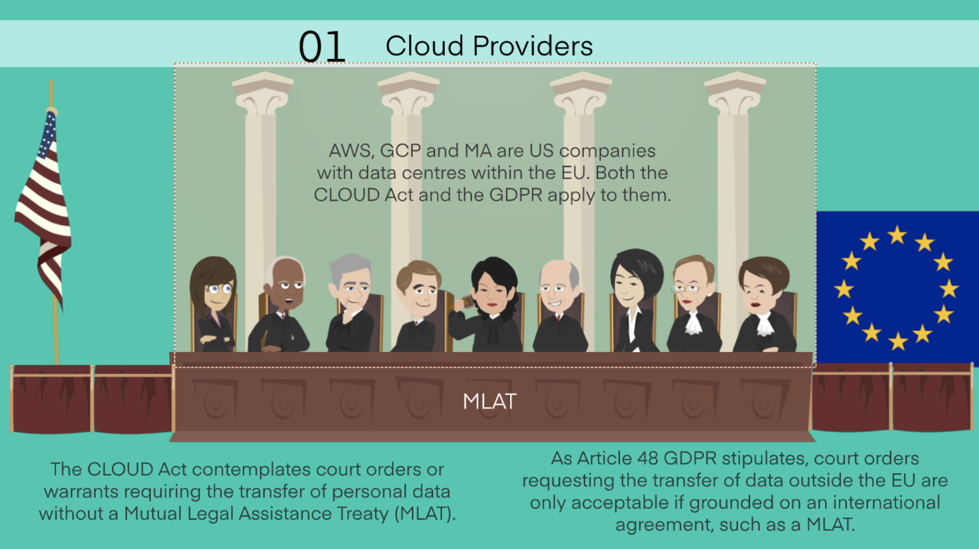
Which Laws Apply to American Cloud Providers?
Confidential
Notes:
General Data Protection Regulation (GDPR) → European Union
The Clarifying Overseas Use of Data Act (CLOUD Act) → USA
Additional information for those customers who want to know more:
The GDPR intends to protect and strengthen the integrity of the individual and to give people power over their data.
The Cloud Act determines that U.S. law enforcement authorities may request personal data from US-based technology companies when there is a suspicion of a crime by issuing warrants or court orders, regardless of the data’s location. Accordingly, a service provider shall disclose any information related to a customer within the provider’s possession “regardless of whether such communication, record, or other information is located within or outside of the US”.
The GDPR intends to protect and strengthen the integrity of the individual and to give people power over their data. From a GDPR compliance point of view, warrants issued on grounds of the CLOUD Act are only acceptable as long as they are based on the EU-US Mutual Legal Assistance Treaty (MLAT).
https://www.activemind.legal/guides/us-cloud-act/

Slide 12
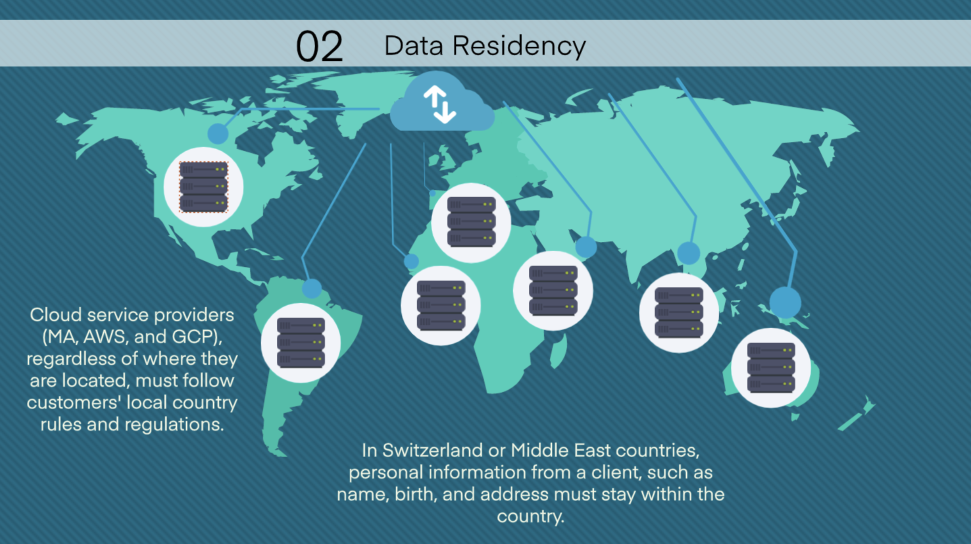
In What Country Will the Data Be Stored?
Confidential
Notes:
Additional information for those customers who want to know more:
In the Middle East, data can be stored in AWS Bahrain. Microsoft can launch hosting options in Saudi Arabia, United Arab Emirates and other Middle East countries. In Switzerland, Microsoft has launched hosting solutions so the data remains there or in the country of choice.

Slide 13
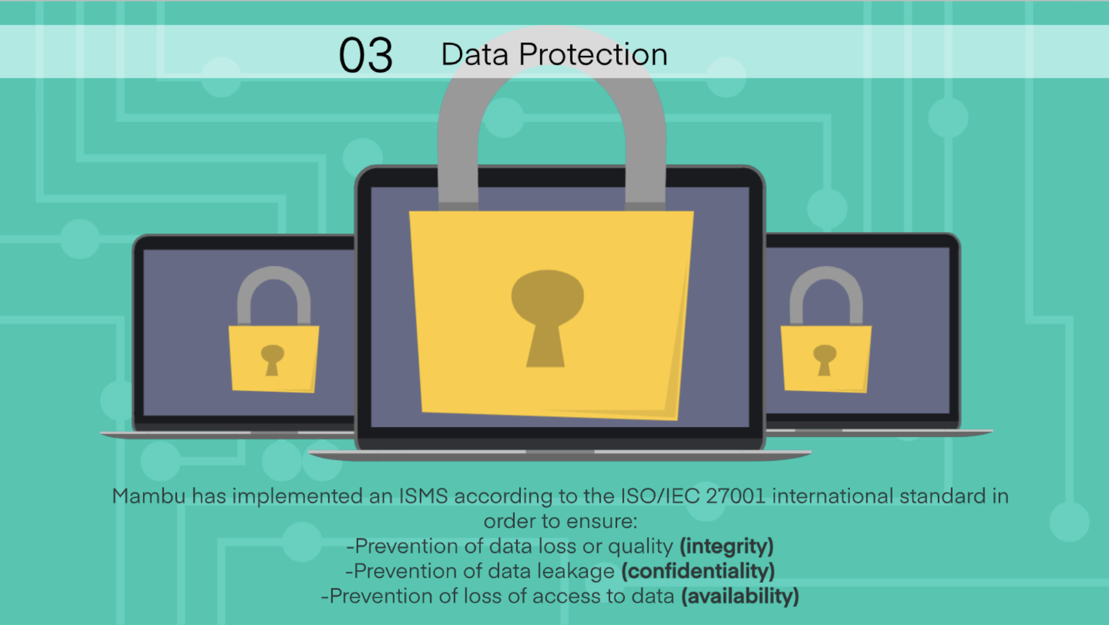
What Level of Data Protection Does the Banking Solution Offer?
Confidential
Notes:
Additional information for those customers who want to know more:
Mambu has also defined a Data Protection Management System (DPMS) consisting of structures, controls, roles with assigned authority and responsibilities and processes to appropriately meet requirements relevant to the EU's General Data Protection Regulation (GDPR).
Information security risks are managed using Mambu’s company-wide risk management framework. Annual as well as ad-hoc information security risk assessments are performed to evaluate the level of protection.

Slide 14
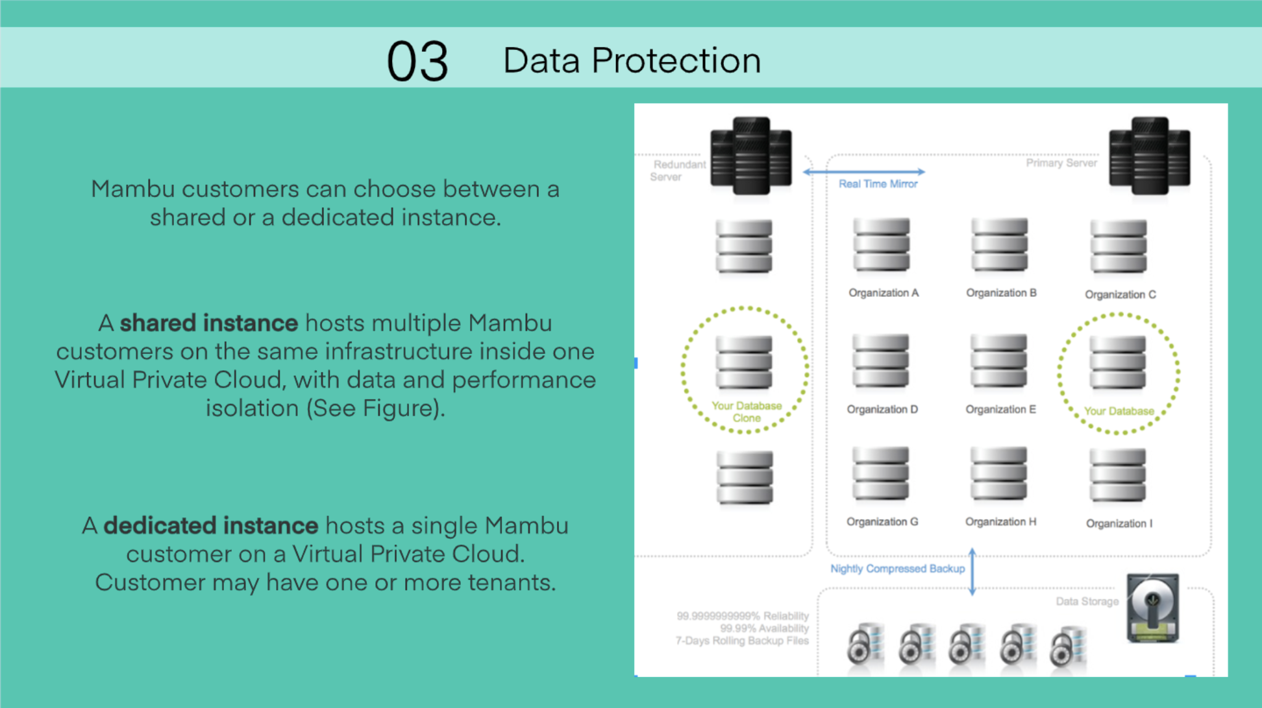
Are There any Differences in Data Protection between Shared and Dedicated Instances?
Confidential
Notes:
Additional information for those customers who want to know more:
A shared instance hosts multiple Mambu customers on the same infrastructure inside one Virtual Private Cloud (AWS VPC, GCP VPC or MA VPC) construct, with data and performance isolation built into the application and database layer. Every customer has their own set of subdomains, which are strictly tied to a dedicated database with a dedicated database user per customer, as shown in the Figure.
A dedicated instance hosts only one or more tenants of a single Mambu customer on a Virtual Private Cloud that is dedicated to that customer. This option is offered for customers who seek additional network and infrastructure isolation.

Slide 15
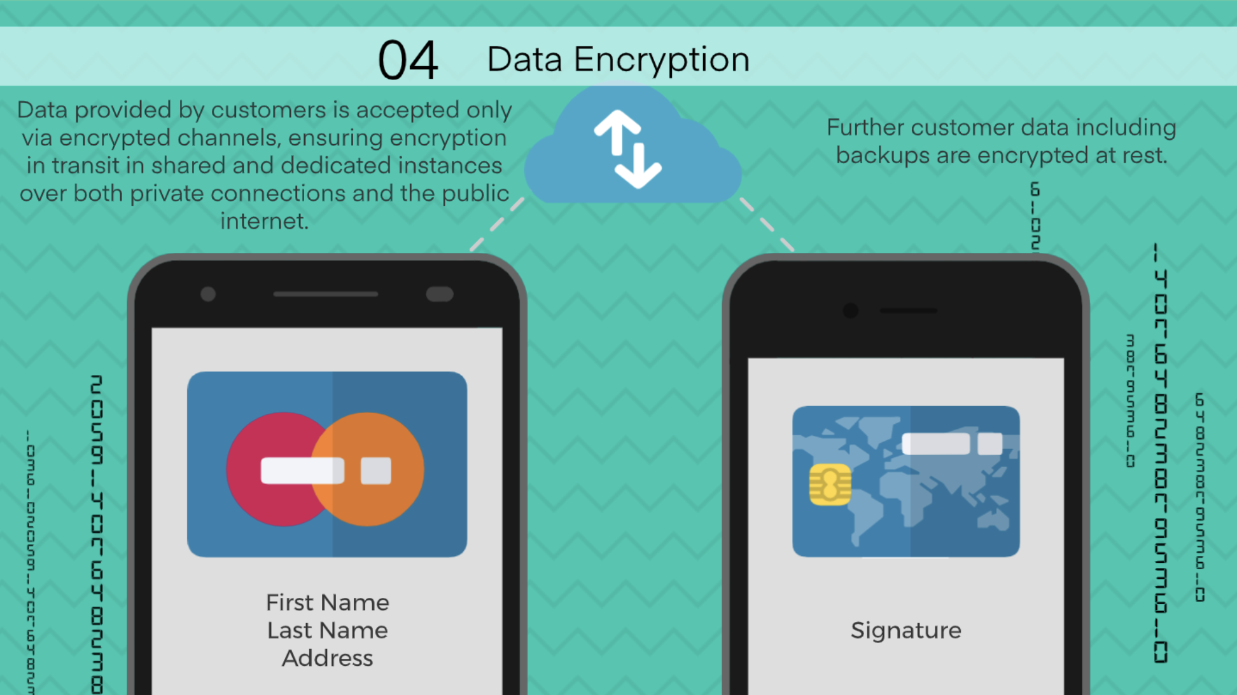
Will Data Be Encrypted Regardless of the Type of Connection Used?
Confidential
Notes:
Additional information for those customers who want to know more:
Encryption in transit applies to both shared and dedicated instances.
Network traffic reaching the Mambu service is protected by firewalls (e.g. AWS EC2 Security Groups or Google Cloud firewall rules), allowing traffic only on ports 80 and 443.

Slide 16
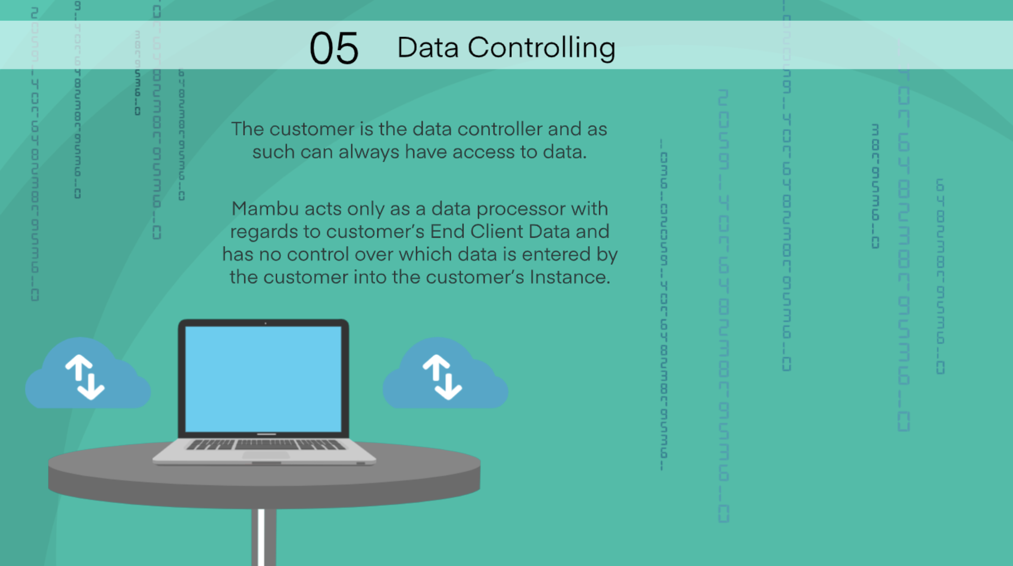
Who Controls the Data?
Confidential
Notes:
Additional information for those customers who want to know more:
Personal data processed by Mambu on customer’s behalf typically involves the following categories of data subjects and data:
Customer Employees: Name (*), contact information (*) (email address, mobile phone number, location) , authentication information (*) (password) and other information (IP addresses).
*Submitted by the customer.
Customer’s (prospective, current and past) End Clients: Name (*), contact information (*) (email address, phone number, address), identity information (*) (copies of ID documents), other personal information (*) (employer information, date of birth, place of birth, gender), authentication information (if Client Portal is used) (*) (password), financial information (*) (financial accounts, transactions, card details), credit related information (*) (credit scores, salary, assets/securities), other information (if Client Portal is used) (IP addresses)
*Submitted by the customer.

Slide 17
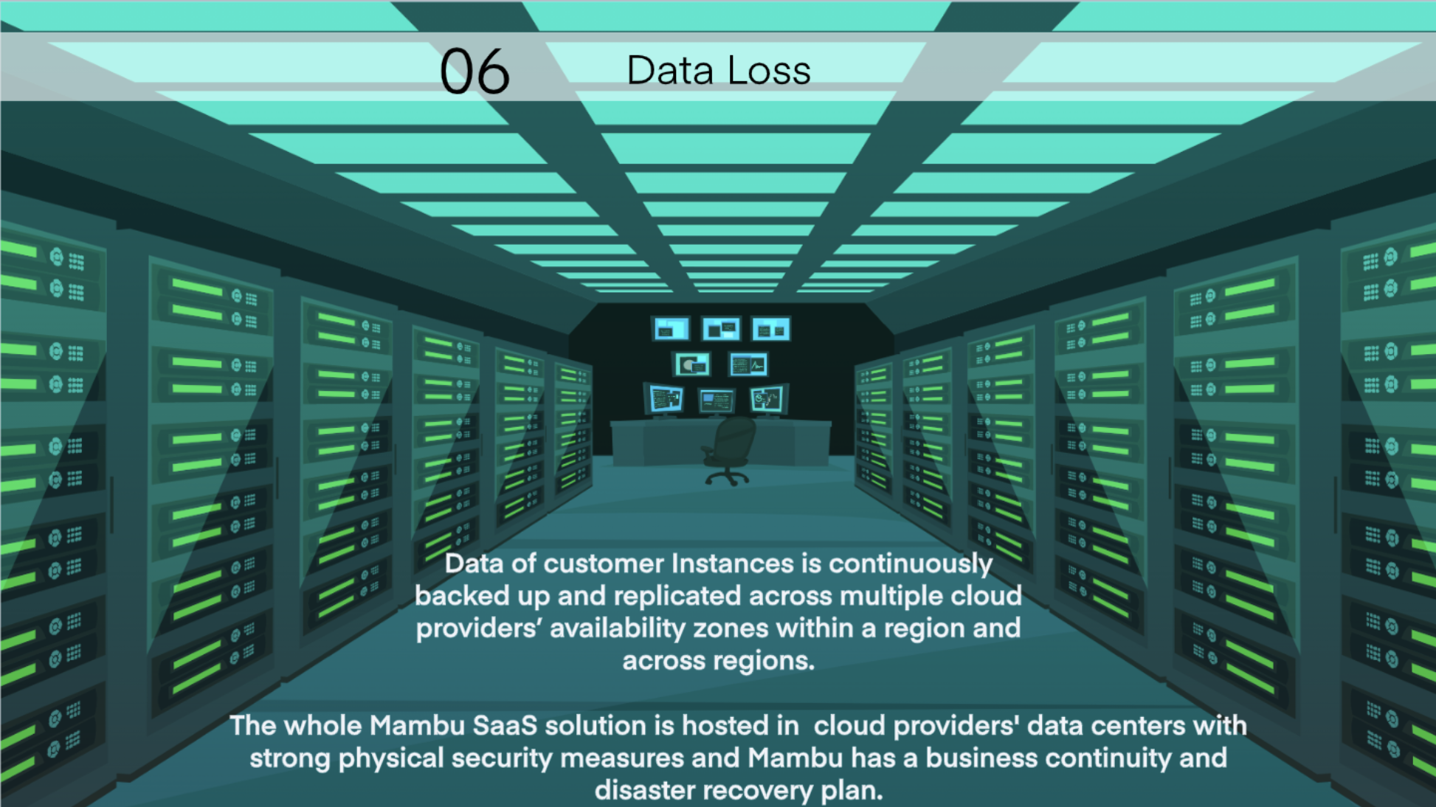
What Measures Are in Place To Avoid Data Loss?
Confidential
Notes:
Additional information for those customers who want to know more:
Mambu has a business continuity and disaster recovery plan which is regularly tested. The plan covers the failover of the Mambu application processing from one cloud provider region to another, allowing customers to continue processing in case a whole cloud provider region becomes unavailable or is severely impacted.

Slide 18
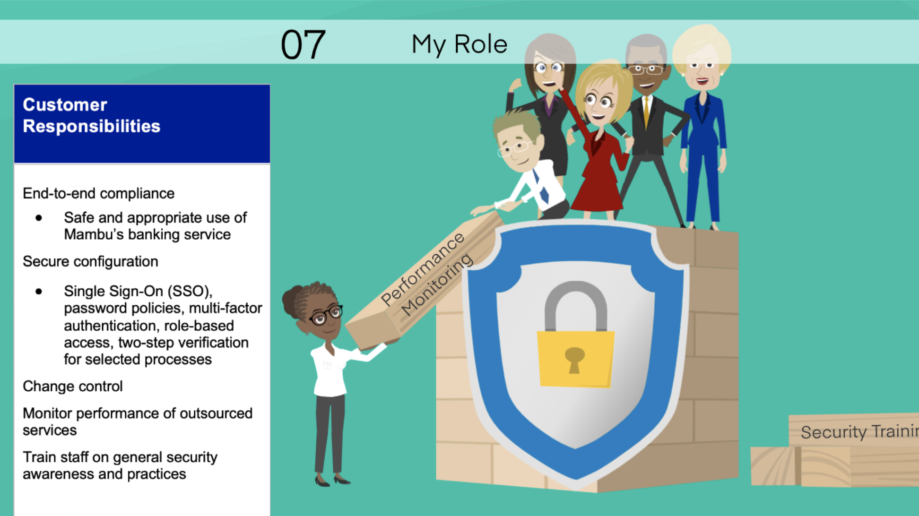
What Are My Responsibilities When Adopting a Cloud Banking Solution?
Confidential

